Slide 1
VR Perspectives
Louis Ginesy

Slide 2
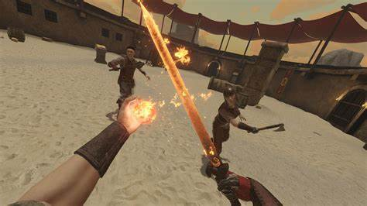
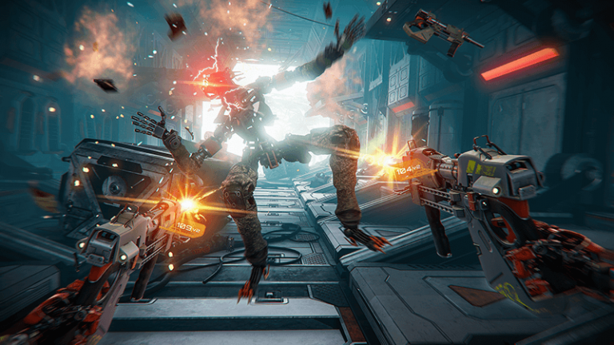
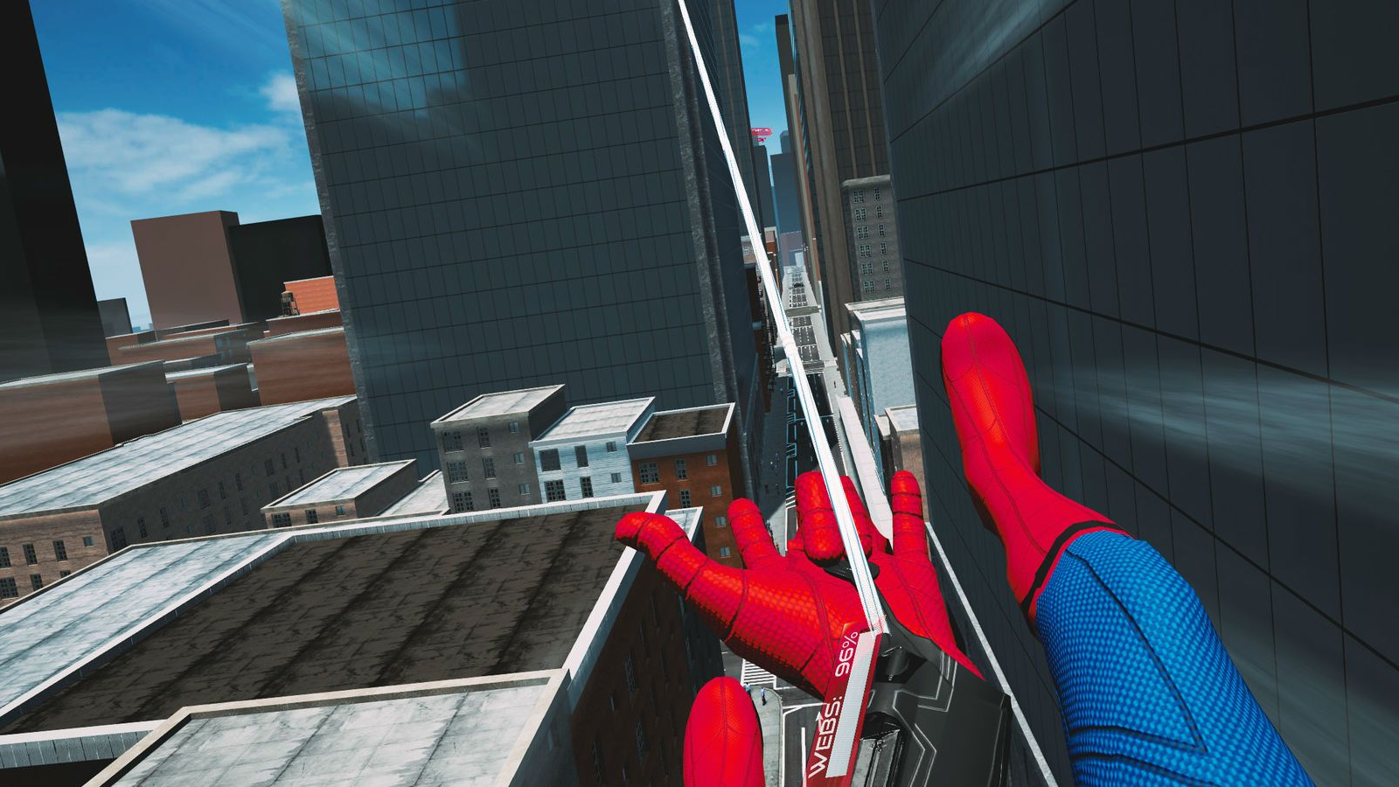
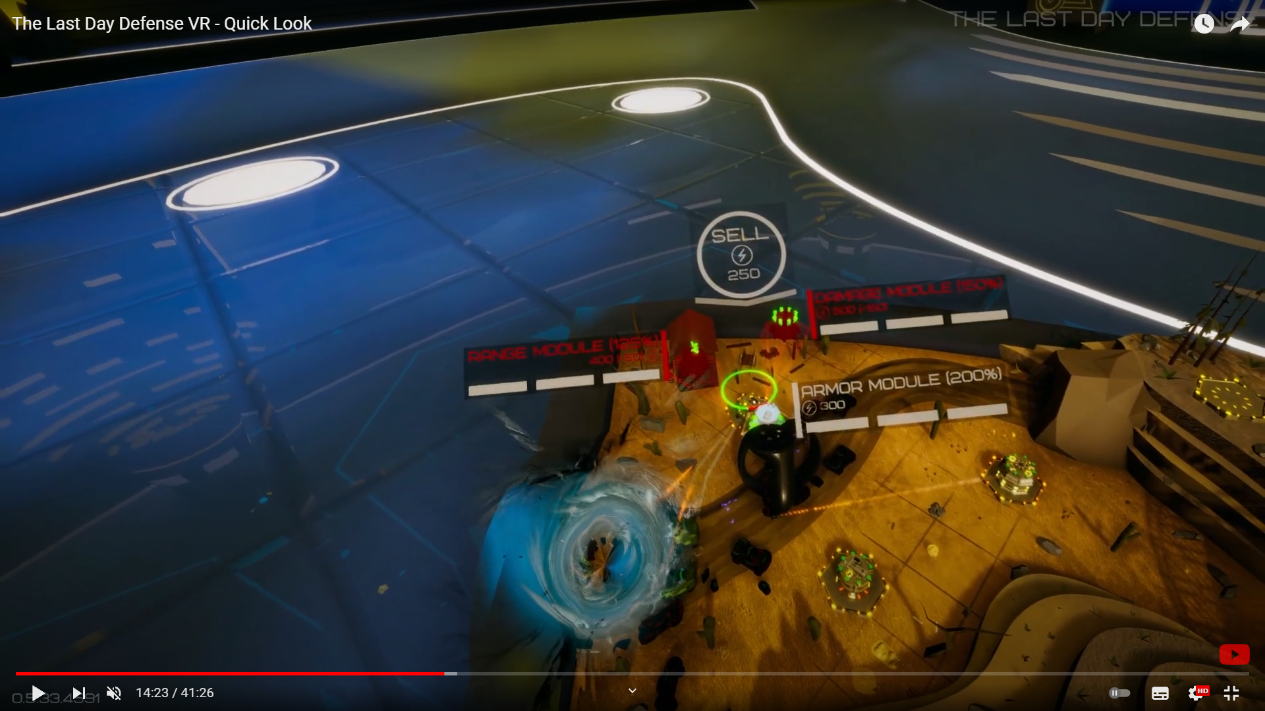
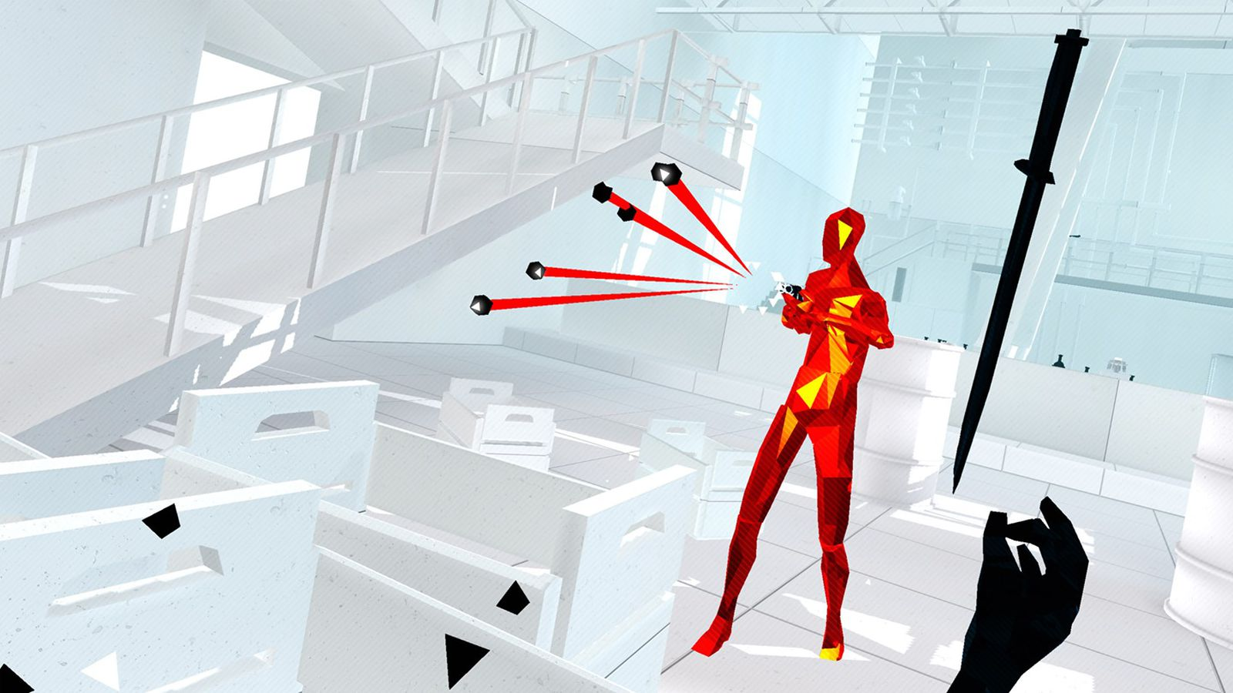
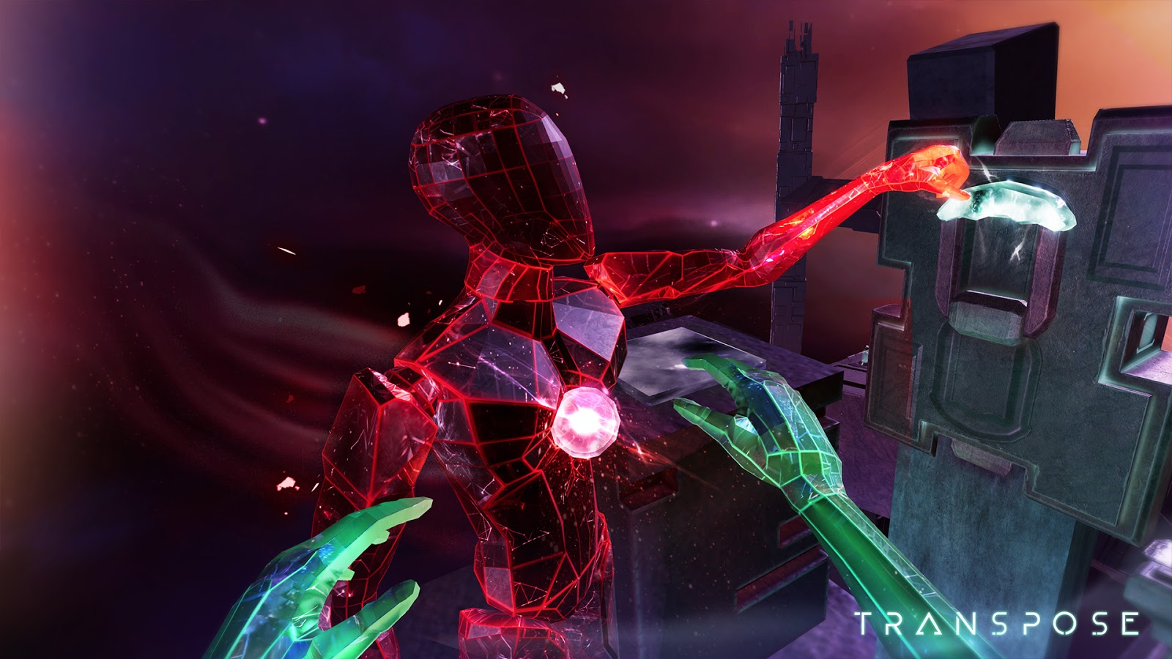
The IDEA: Explore alternative Perspectives in VR Applications

Slide 3
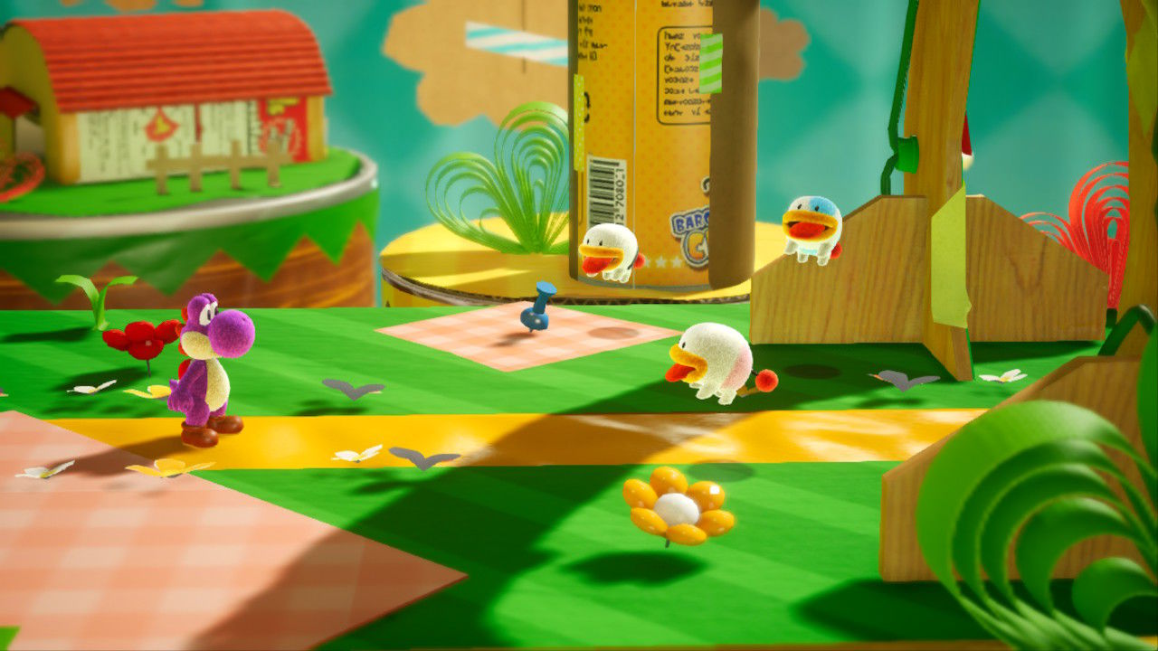
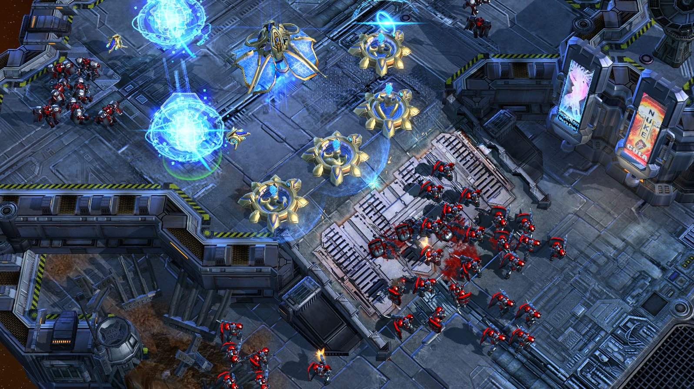
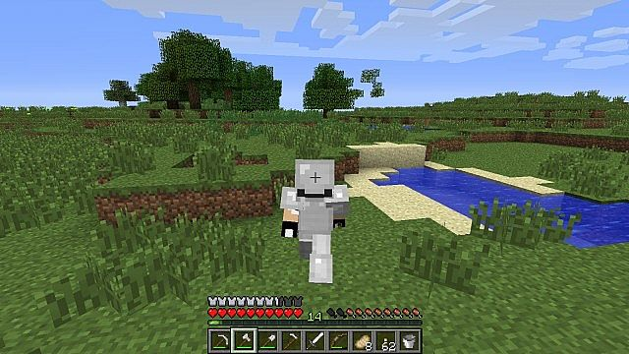
The IDEA: Explore alternative Perspectives in VR Applications

Slide 4
State of the art
3PP-R: Enabling Natural Movement in 3rd Person Virtual Reality | Inan Evin, Toni Pesola, Maximus D. Kaos, Tuukka M. Takala, Perttu Hämäläinen
Characterizing first and third person viewpoints and their alternation for embodied interaction in virtual reality | Henrique Galvan Debarba, Sidney Bovet, Roy Salomon, Olaf Blanke, Bruno Herbelin, Ronan
Characterizing embodied interaction in First and Third Person Perspective viewpoints | Henrique G. Debarba, Eray Molla, Bruno Herbelin, Ronan Boulic
Keep my head on my shoulders!: why third-person is bad for navigation in VR | Daniel Medeiros, Rafael K. dos Anjos, Daniel Mendes, João Madeiras Pereira, Alberto Raposo, Joaquim Jorge
First- and Third-Person Perspectives in Immersive Virtual Environments: Presence and Performance Analysis of Embodied Users | Geoffrey Gorisse, Olivier Christmann, Etienne Armand Amato, Simon Richir

Slide 5
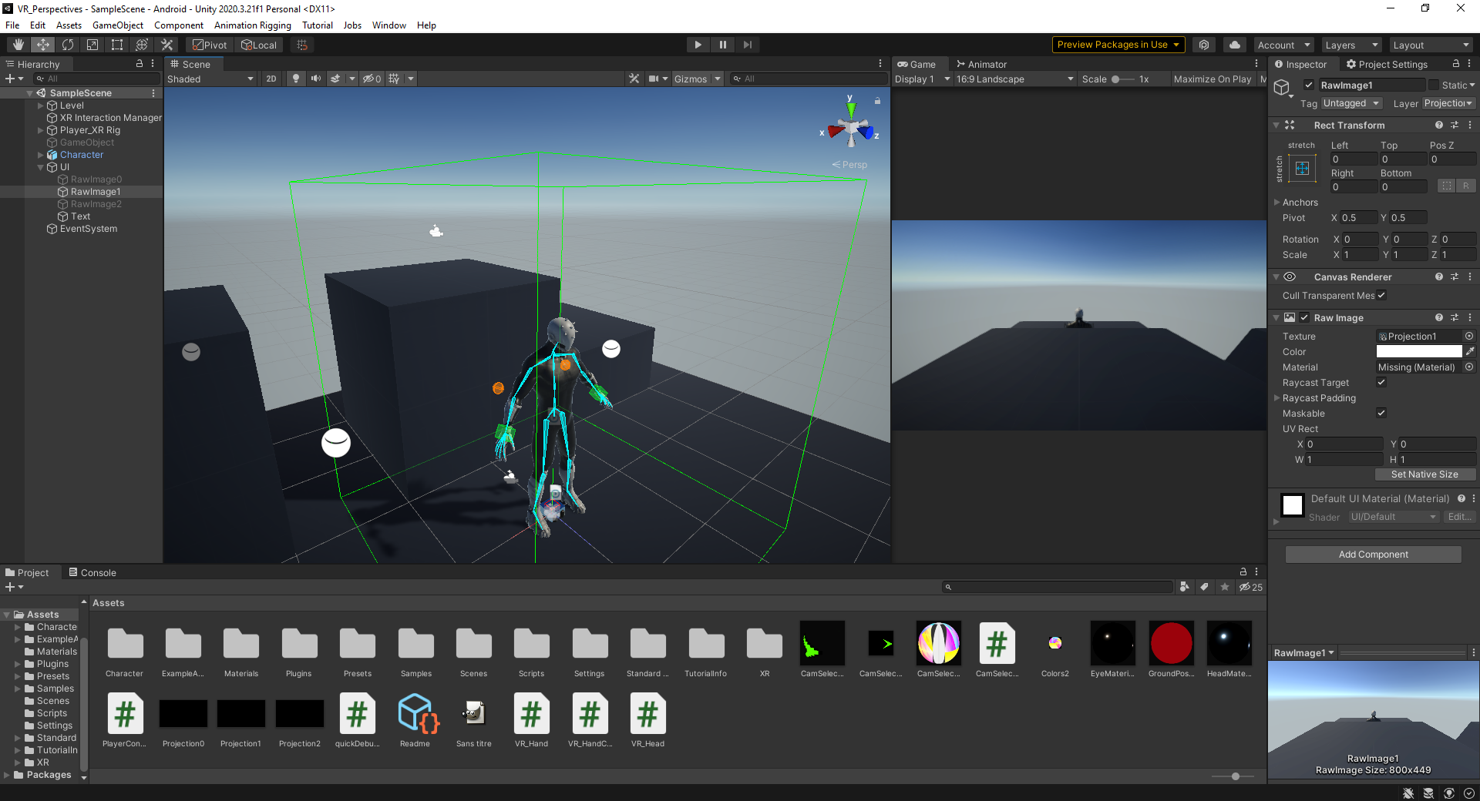
Current State of the Project
Camera redirection using a projection plane
IK for hands and head
Move and rotation via sticks or movement
Selection between different cameras in game

Slide 6
What’s next ?
Fix and Improve the existing IKs
Add IK for legs to simulate walking
Add a simple grab system
Add the other cameras planned

